Slide 1

Online Shoppers Purchase Intention
Presenter:
Anudeep Subraveti
Data Science Graduate Student – Oklahoma State University

Slide 2

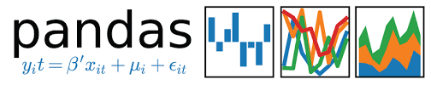





Data Science Tools Used:
Data Analysis
Model Building
Visualization

Slide 3



Agenda
Business Opportunity
Methods
Analysis

Slide 4
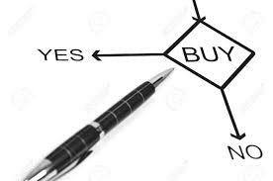
Business Challenge
To develop a model that predicts the online shoppers purchase intention, i.e., to predict whether a customer visit to the online website leads to a purchase ( Revenue Generation ) or not.
Business Opportunity
Methods
Analysis

Slide 5
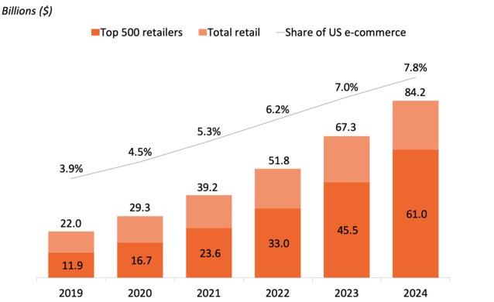
Business Opportunity
Why is it important ?
$ 3.45 Trillion
2019
Grew 23.3% over last year
~ 81% in USA (At least Once)
Only 2.86% converts into purchase
Business Opportunity
Methods
Analysis

Slide 6







Project Pipeline
Data Collection (.CSV)
Exploratory data analysis
Data Preparation
Holdout Split
Stratified KFold
Model Building
Model Evaluation Metrics
Business Opportunity
Methods
Analysis

Slide 7
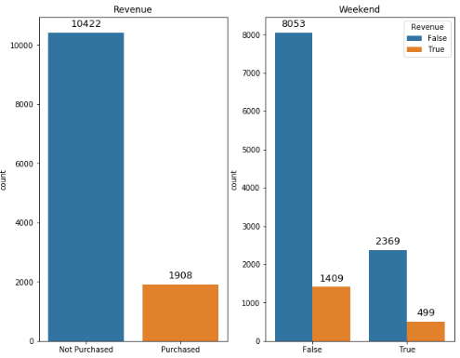
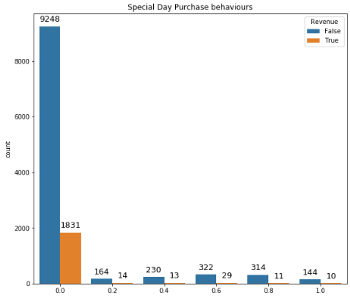
Exploratory Data Analysis
Business Opportunity
Methods
Analysis

Slide 8
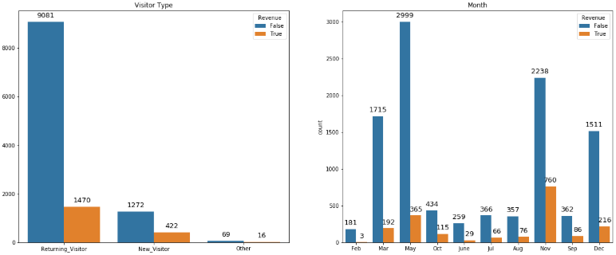
Exploratory Data Analysis
Business Opportunity
Methods
Analysis

Slide 9
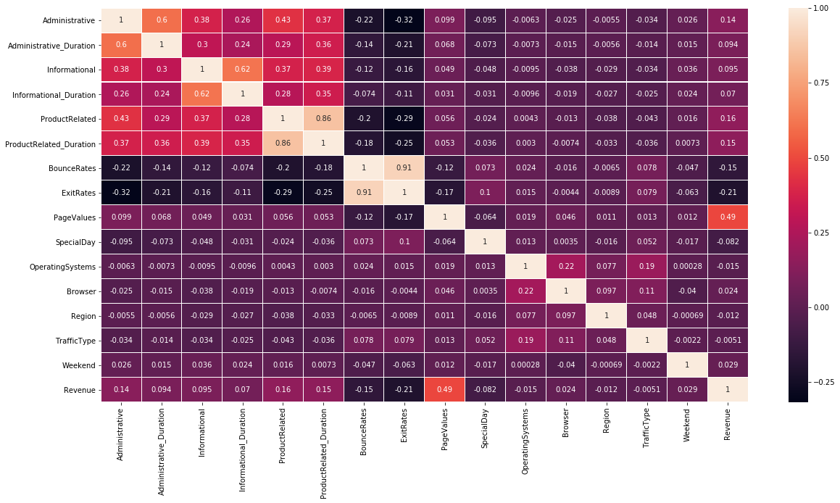
Correlation Matrix
Business Opportunity
Methods
Analysis

Slide 10
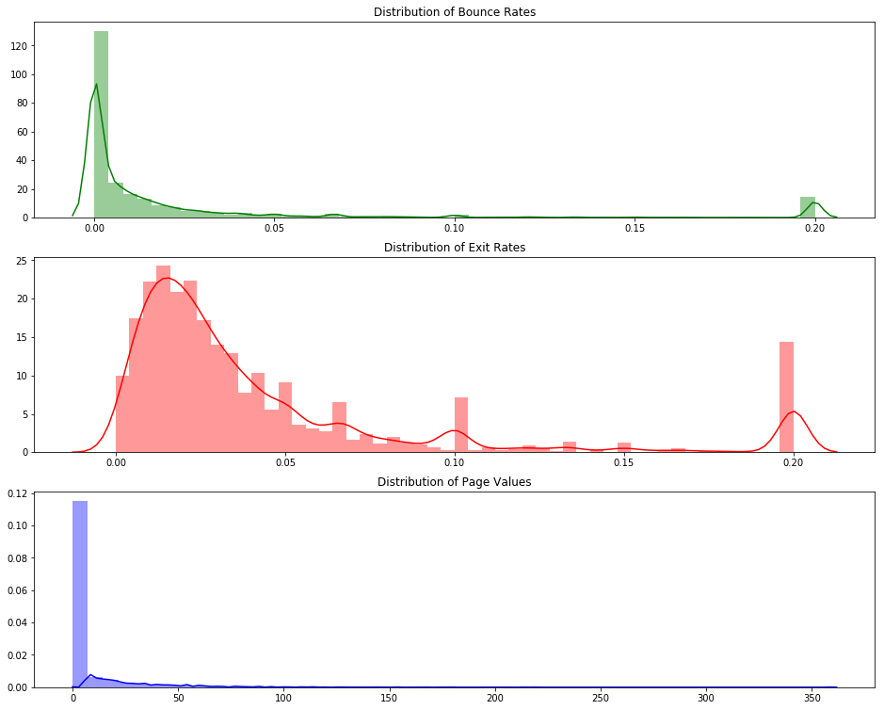
Exploratory Data Analysis
Business Opportunity
Methods
Analysis

Slide 11
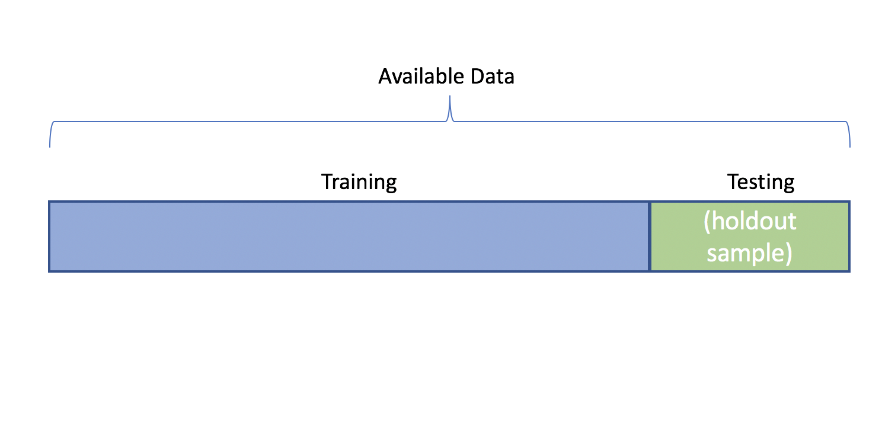
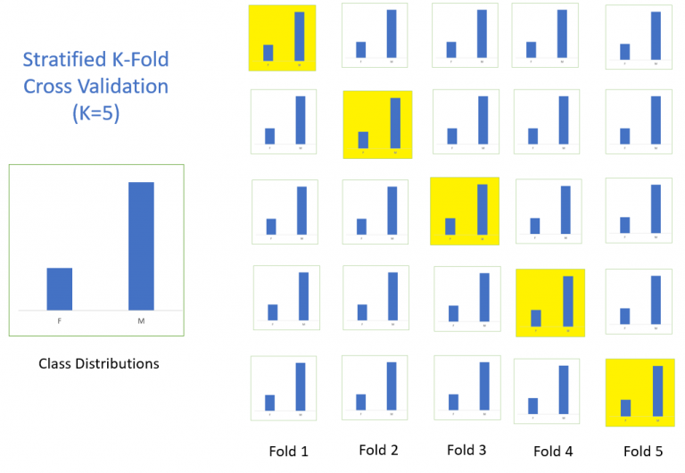
Model Building
Random Forest
Neural Networks
Logistic Regression
Support Vector Machine
Business Opportunity
Methods
Analysis

Slide 12
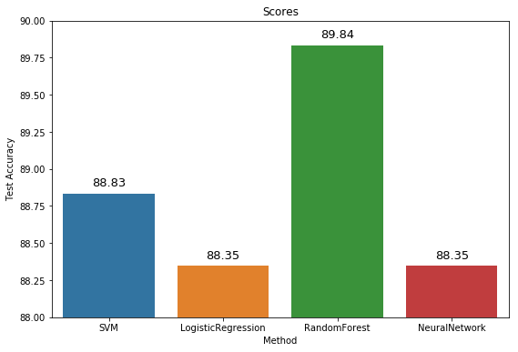
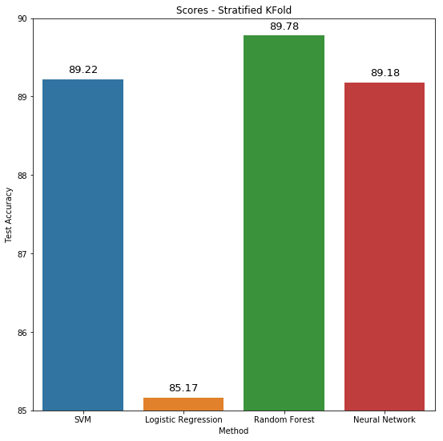
Model Evaluation - Accuracies
Holdout Validation
Stratified Kfold Validation
Business Opportunity
Methods
Analysis

Slide 13
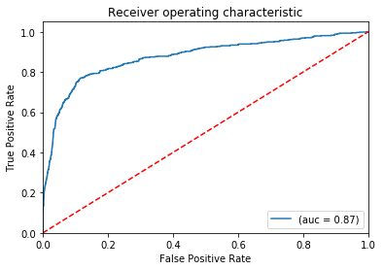
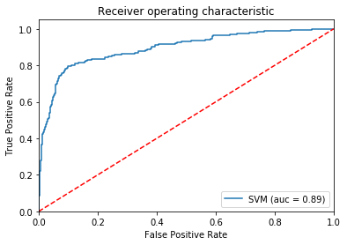
Model Evaluation – Support Vector Machine
Holdout Validation
Stratified Kfold Validation
Accuracy : 88.83
Precision : 82
Recall : 72
F1 Score : 75
Accuracy : 89.2
Precision : 74.5
Recall : 45.9
F1 Score : 57
Business Opportunity
Methods
Analysis

Slide 14
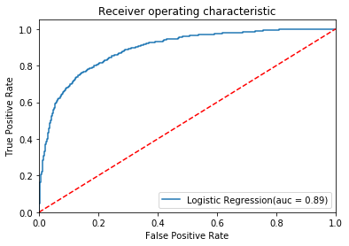
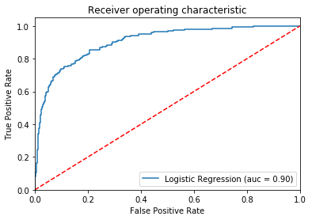
Model Evaluation – Logistic Regression
Holdout Validation
Stratified Kfold Validation
Accuracy : 88.34
Precision : 83
Recall : 67
F1 Score : 71
Accuracy : 85.1
Precision : 51.4
Recall : 76.3
F1 Score : 61.4
Business Opportunity
Methods
Analysis

Slide 15
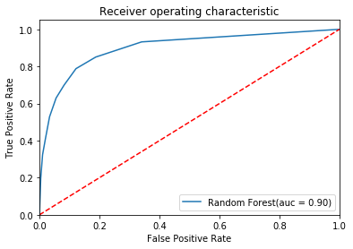
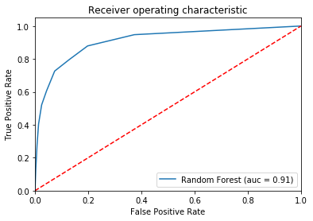
Model Evaluation – Random Forest
Holdout Validation
Stratified Kfold Validation
Accuracy : 89.84
Precision : 84
Recall : 75
F1 Score : 79
Accuracy : 89.5
Precision : 73.3
Recall : 51.6
F1 Score : 60.5
Business Opportunity
Methods
Analysis

Slide 16
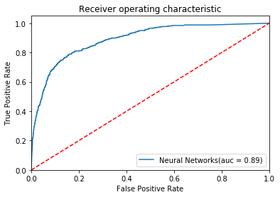
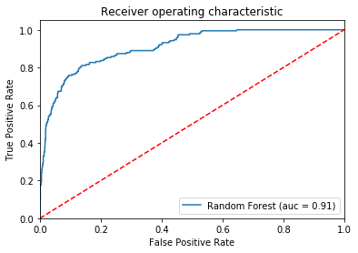
Model Evaluation – Neural Networks
Holdout Validation
Stratified Kfold Validation
Accuracy : 88.34
Precision : 78
Recall : 76
F1 Score : 77
Accuracy : 89.2
Precision : 68
Recall : 57
F1 Score : 62
Business Opportunity
Methods
Analysis

Slide 17
Thank you

Slide 18
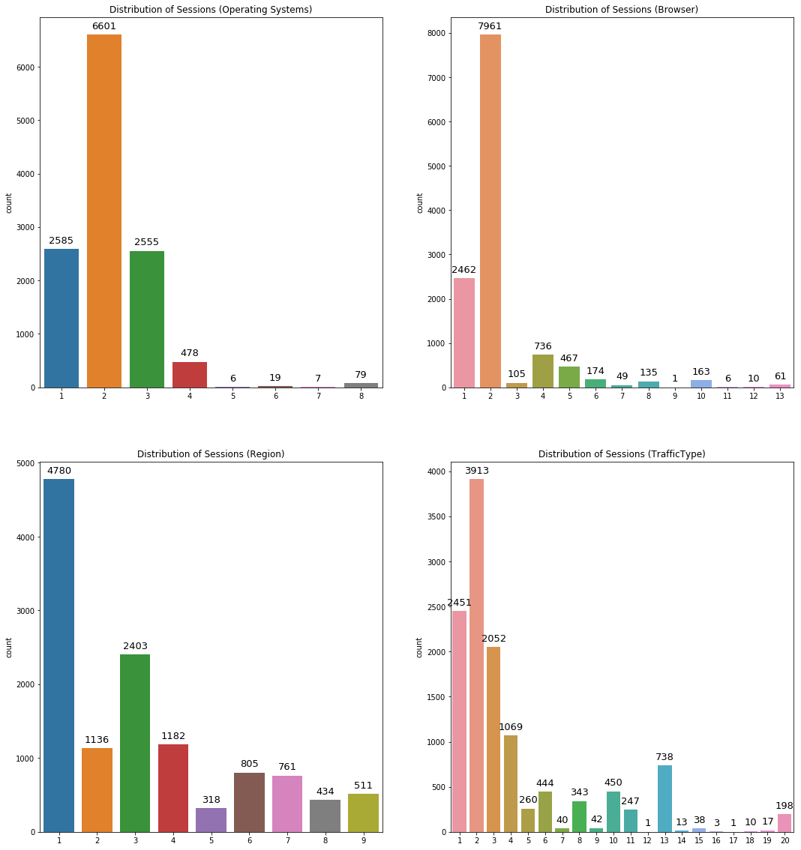
Appendix:

Slide 19
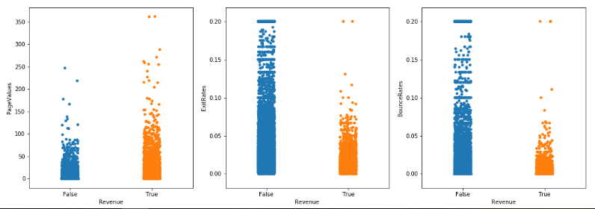
Appendix:

Slide 20
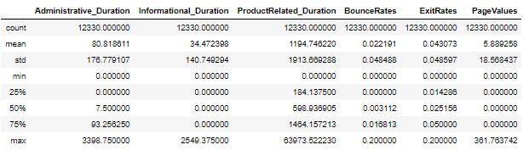
Appendix:

